Slide 1
BENGALURUS
GREENEST PARTS
Gurusankar K PES1201800114
Amrutha U PES1201801879
Srinidhi T PES1201800255

Slide 2
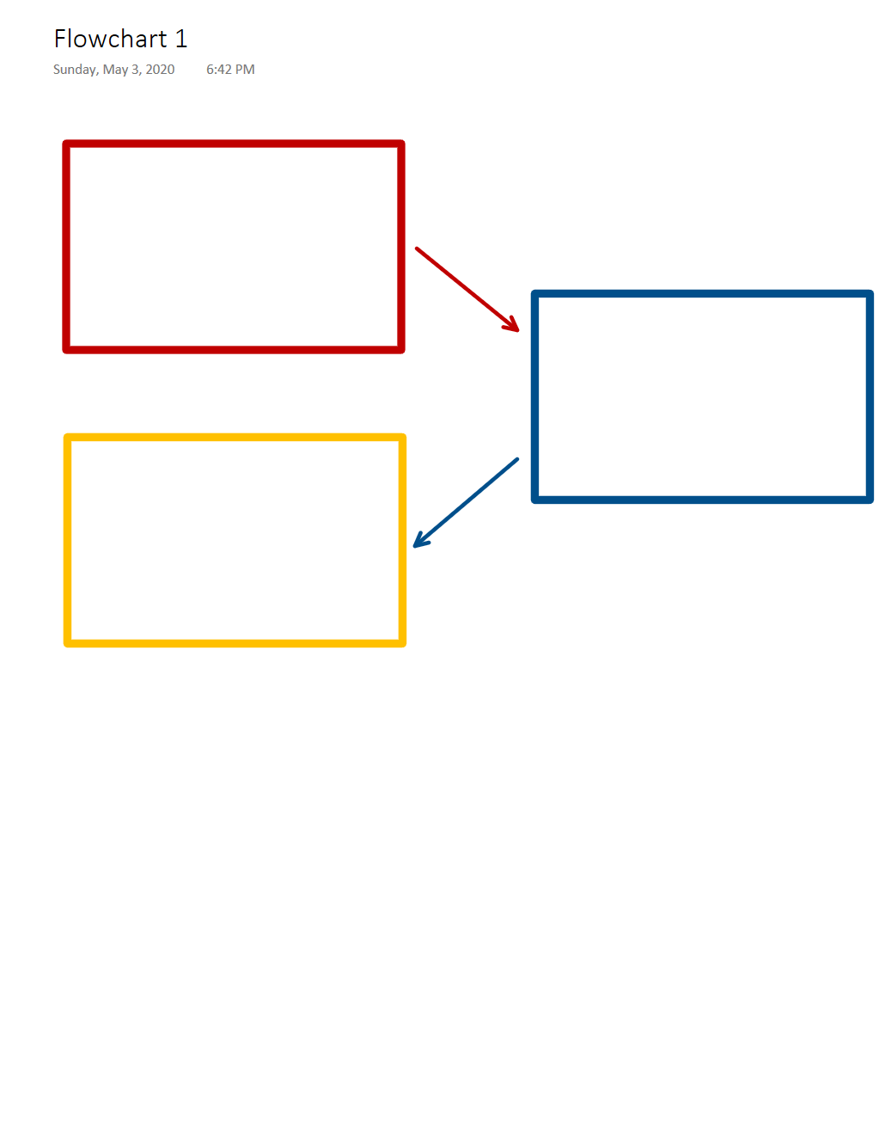
Satellite pictures of 198 wards
Green cover analysis (OpenCV)
Data analysis (Hadoop Map-Reduce)
Notes:
The project was broken down into three phases in following the data flow based upon the processing modules. The first being data collection. After exploring the feasibility in terms of time and complexity of segmenting Bangalore in various ways, we chose the 198 wards in favor of its logical appeal as a result over the other two ideas, viz., breaking it into small identical boxes, and marking regions based on latitude and longitude. The next phase analyses the percentage of green (green-cover) observed within the boundary of each wards’ satellite image and generates a report for further processing. The final phase uses Hadoop’s Map-Reduce algorithms to generate a file containing the list of wards whose green-cover exceeds 75%.
Without further ado, let’s begin with the first phase.

Slide 3
DATA COLLECTION

Slide 4
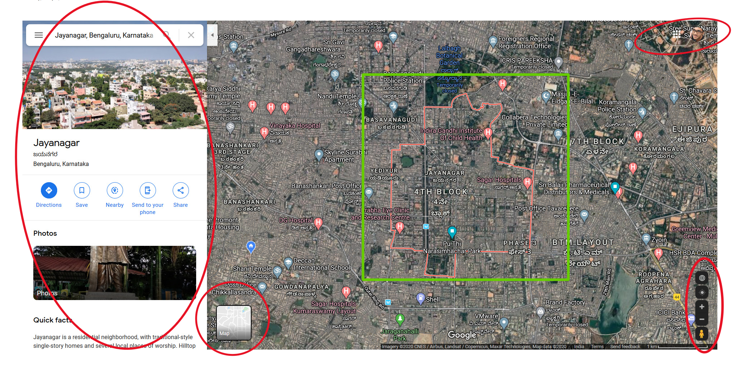
Selenium 3.141 – Python 3.x – Firefox 75.0
Notes:
Upon searching for a ward in google maps, we get the following webpage. All the regions marked in red aren’t of any use. In fact, the only region of importance has been highlighted by the green square. And that is the result we expect to get from the first phase.
Data collection has been implemented using Python 3.8 and Selenium for Python. Mozilla Firefox was the chosen Web Browser and Geckodriver as the selenium Webdriver.
A text document containing a list of 198 wards Bangalore was created by scraping the data from Wikipedia.
Iterating through the list, each entry is searched in Google Maps and screenshots are taken. The screenshot is cropped to the green square, removing everything but the region of interest. But, there is significant noise contributed to the picture by the labels which would in turn affect the results achieved from phase 2.

Slide 5
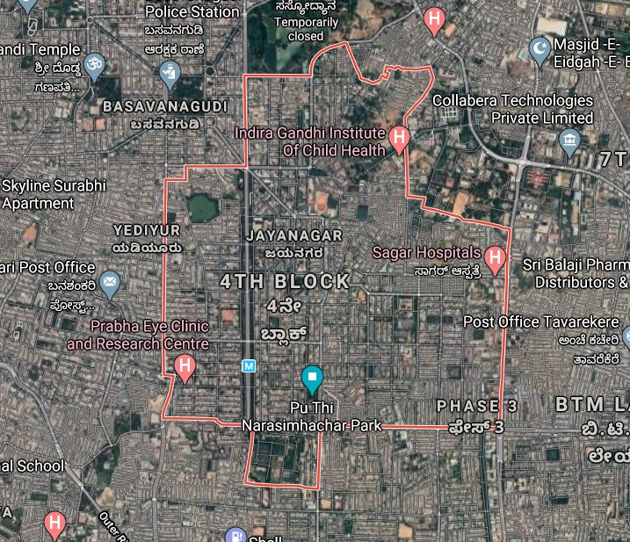
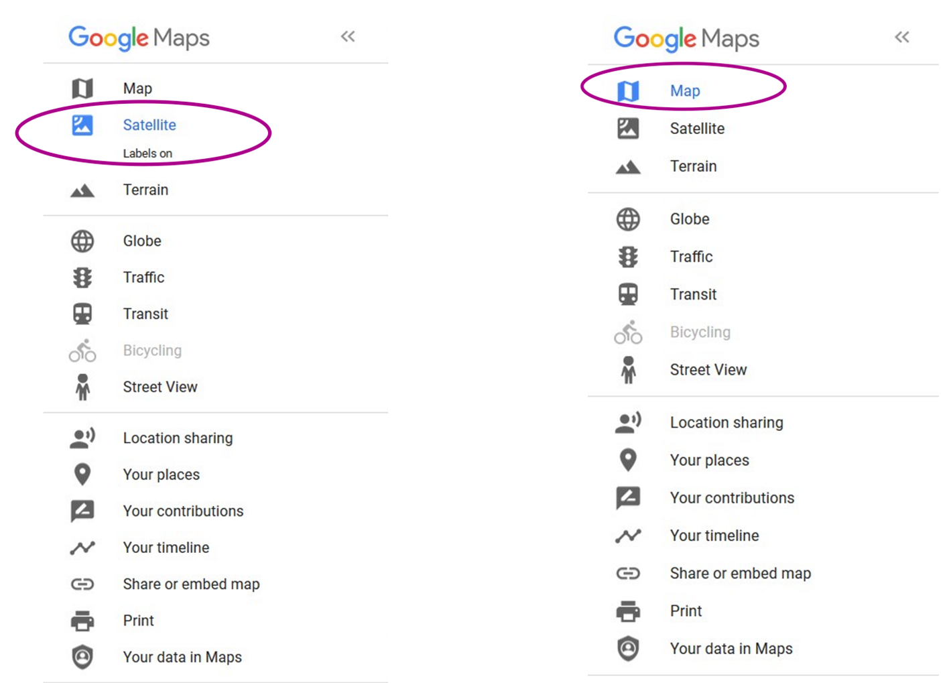
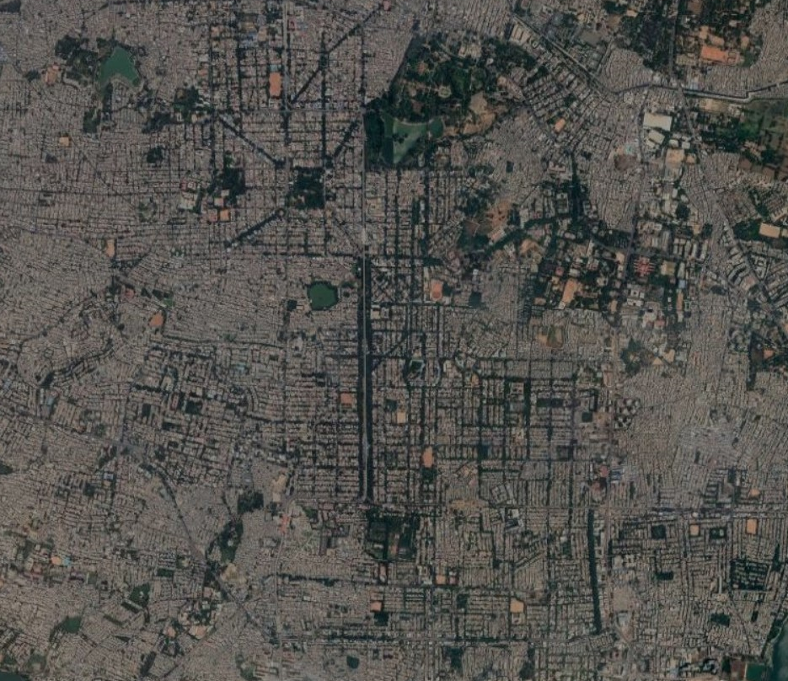
Notes:
In the satellite view, Maps allows us to toggle the labels on and off. But, the following is observed in the satellite view. When the labels are removed, the red outline of the ward is also hidden. This would have worked well, only if the red outline remained. What if there was such an option with the political map?

Slide 6
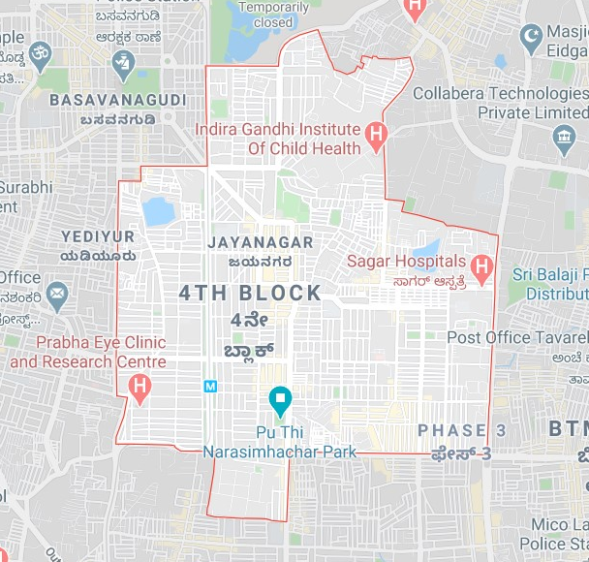
?
Notes:
As we see here, we don’t have that option provided with it. Digging a little further on the literature and hacks available on the web, we discovered something of use.

Slide 7
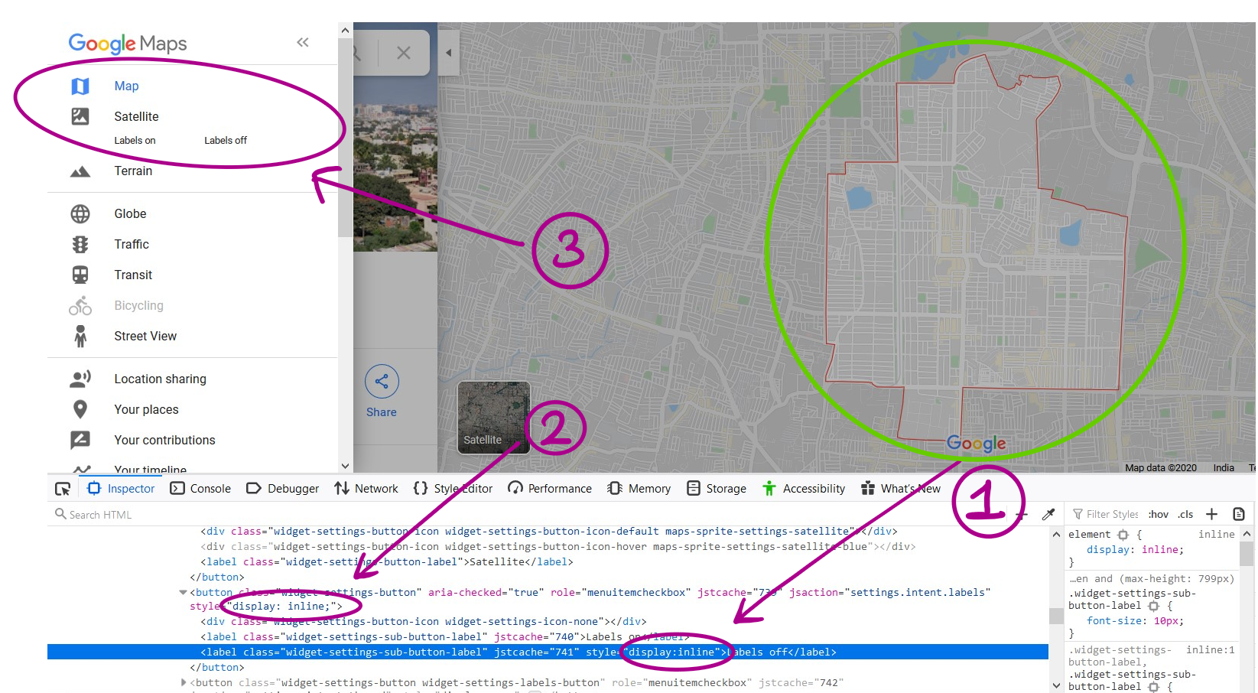
Notes:
It was learnt that the function call still remains available on the webpage and is merely hidden. So upon changing the widget’s attribute from `display:none` to `disiplay:inline` we were able to access those function available solely for the satellite view. Toggling those functions a favorable result was achieved. The result is highlighted by the green circle – a simple outline of the ward. But, this process has to be repeated for every search result because of the page reload that follows, thus returning these attributes to default. Now, if care is taken to keep the image stationary and simply toggle between the satellite view and the improvised political view, the following is observed.

Slide 8
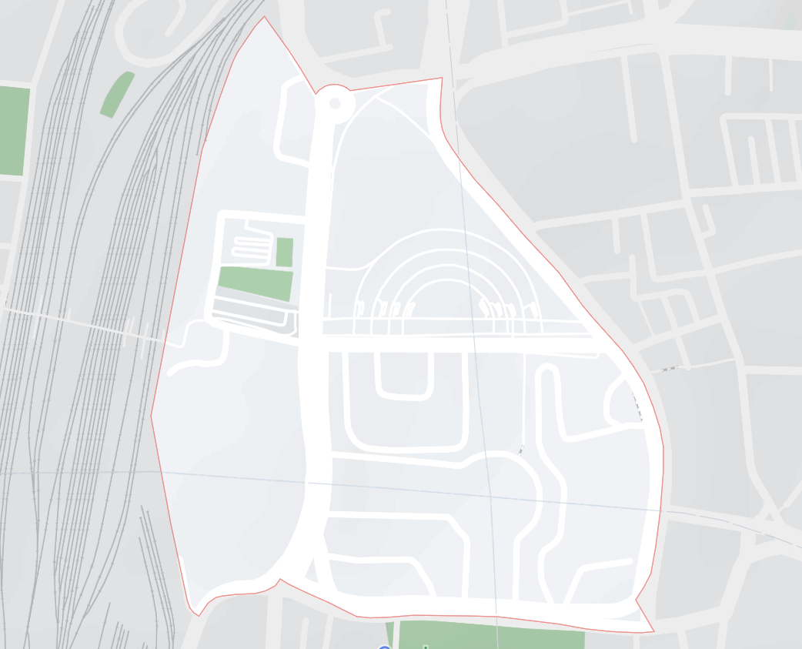
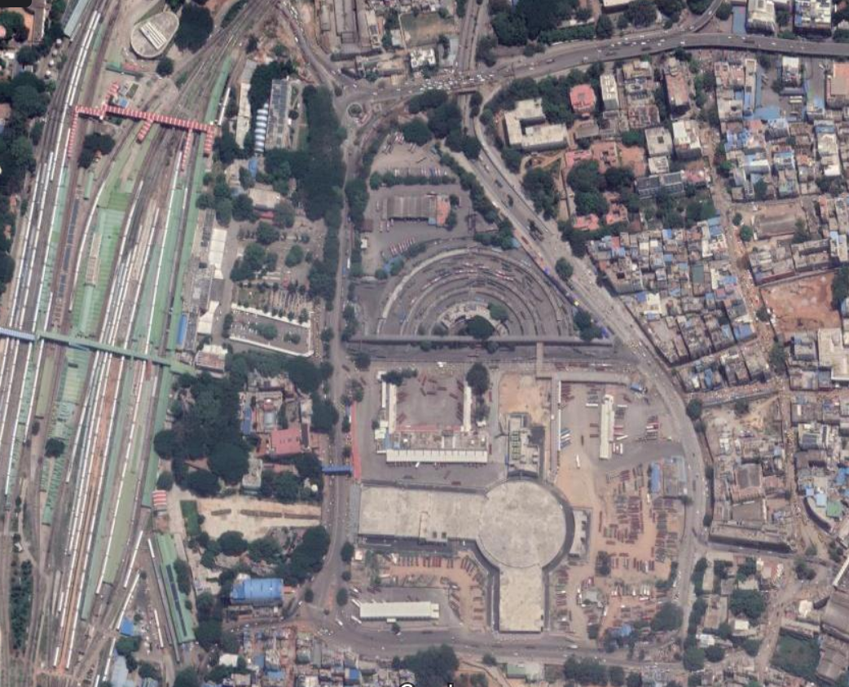
1 outline Kempegowda.png
1 Kempegowda.png
Notes:
These two images are one of the actual pair of images generated from the script, whose entire set can be found in the drive. One minor detail that was left out: the `terrain` option was also toggled and switched off for the pictures as it further reduced noise. This first version of the script performed accurately, but only satisfactorily. Two major things struck out, the first of which is…

Slide 9
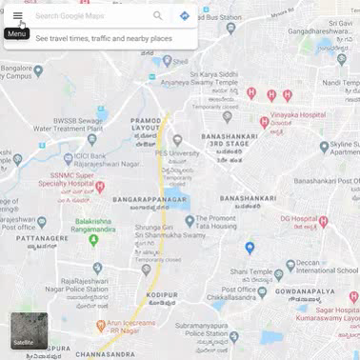
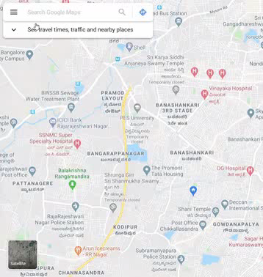
With animations
Without animations
Notes:
Efficiency. It took quite long. (Each map needed to be searched and retrieved, modify the webpages’ CSS to access the improved political map and finally screenshot in 2 different views.) For each ward, that is each pair of screenshots, it took about 10 seconds. For 198 wards, that scales to 33 minutes. To improve this time, we identified and tackled the largest bottleneck: animations and transitions. If we could remove this, we could significantly reduce page load times as shown. Disabling it manually wasn’t straightforward. Many attempts at changing the default CSS resulted in unresponsive webpages. So another method was employed. A browser addon, otherwise known as an extension, called `no transition` was used to disable the animations and transitions. This sped up the entire process, and now each ward was screenshot in 5 seconds. Phase 1 could now be completed in 15 minutes.

Slide 10
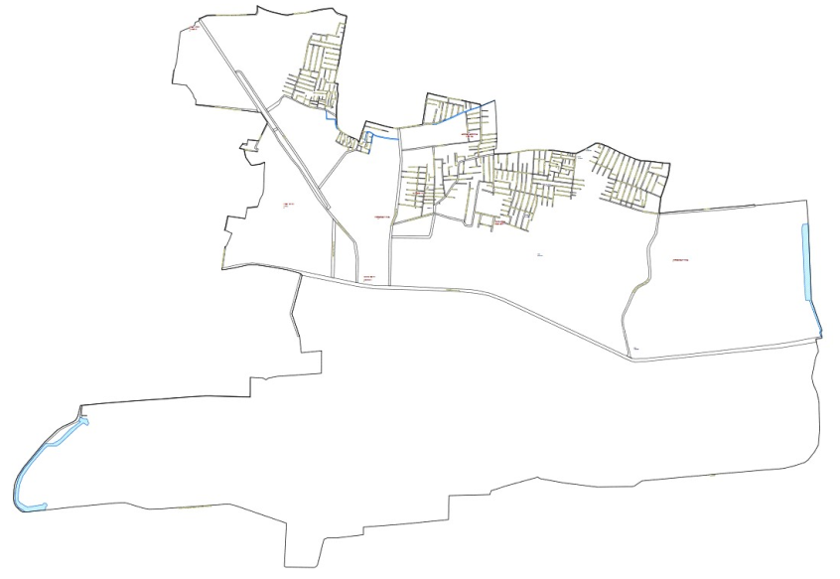
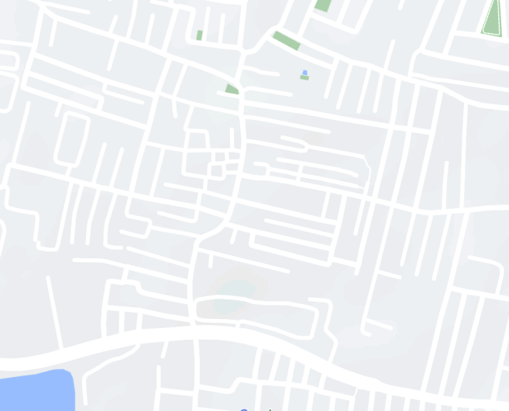
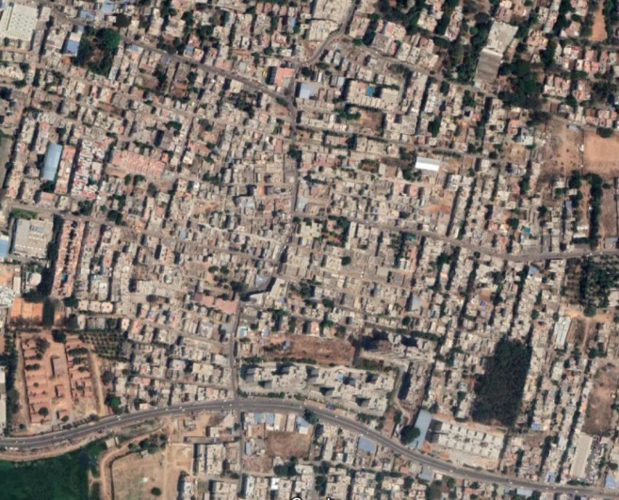
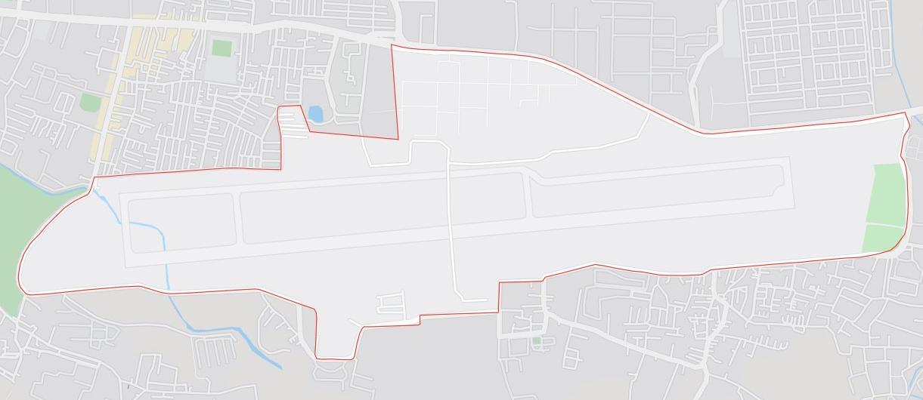
Chowdeswari
HAL Airport
Notes:
The second equally important drawback was the inaccuracy. Some searches did not turn up a search result as shown for Chowdeswari on the left. In many cases, the ward boundary from BBMP did not resemble the boundary shown by the Map as shown on the right. About 30 such cases was found in total. This hasn’t been corrected. Efforts towards overcoming this drawback are sustained even now, but has not availed much result.

Slide 11
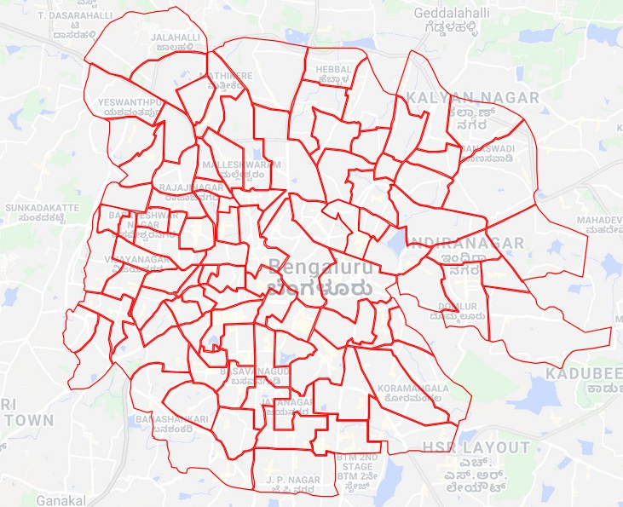
“JsAction is a tiny event delegation library that allows decoupling the DOM nodes on which the action occurs from the JavaScript code that handles the action.”
Notes:
The correct boundaries have been redrawn and uploaded for the public by a helpful person on a service called `my maps` by google, unfortunately whose development has been stopped for a few years. It does not have the nifty features of removing the labels as is now available Google Maps. We attempted to transplant the javascript of the Maps webpage into the ‘My Maps` webpage but were stopped in our efforts by x factors: 1, google uses its own Open Source library called ‘jsaction` to couple the event and the event-handler. This library aims to abstract the form from function. So then, after understanding the workings of jsaction, the function was profiled and traced. The function which removes the labels had been identified, but it’s dependency tree could not be constructed manually as it involved more than 20 functions. Other options are currently being explored. With this, discussion of Phase 1 ends, and the data collected from Phase 1 is fed into Phase 2.

Slide 12
Image Processing using OpenCV

Slide 13
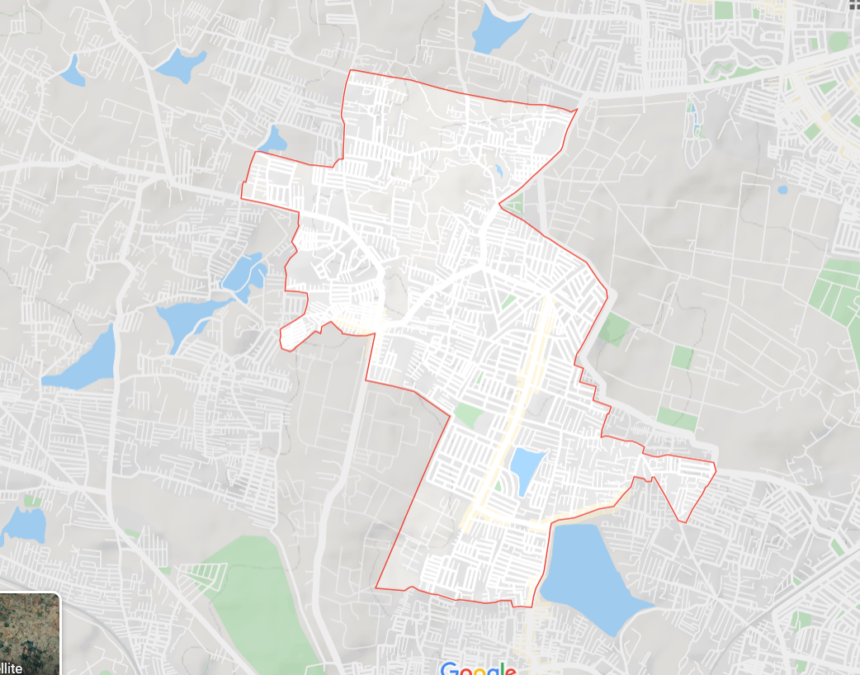
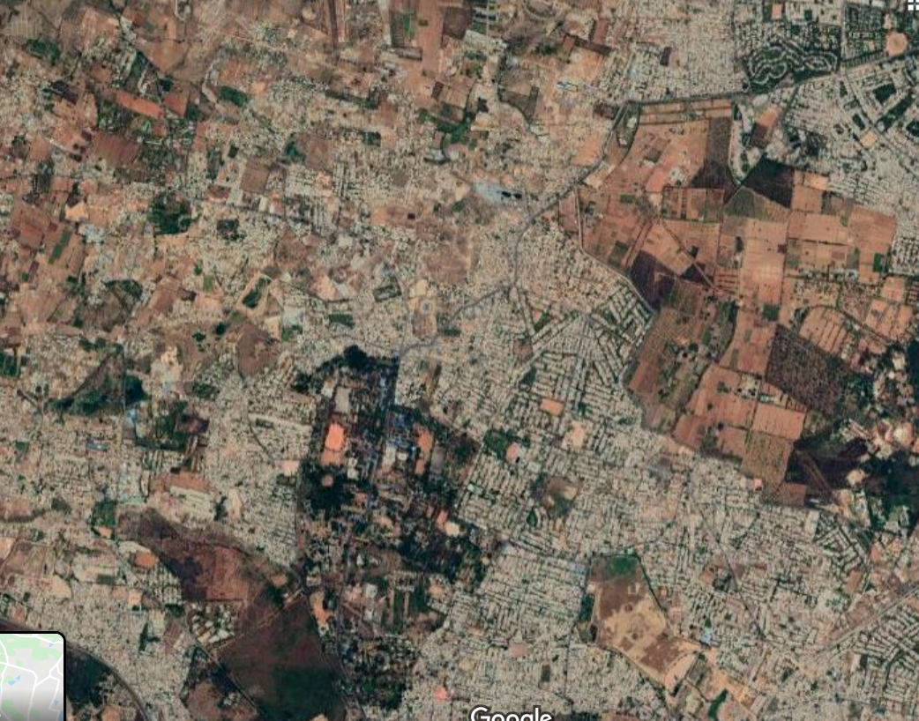
Data collected for a randomly selected ward
Ward-9 : Vidyaranyapura Ward
Vidyaranyapura map view
Vidyaranyapura satellite view

Slide 14
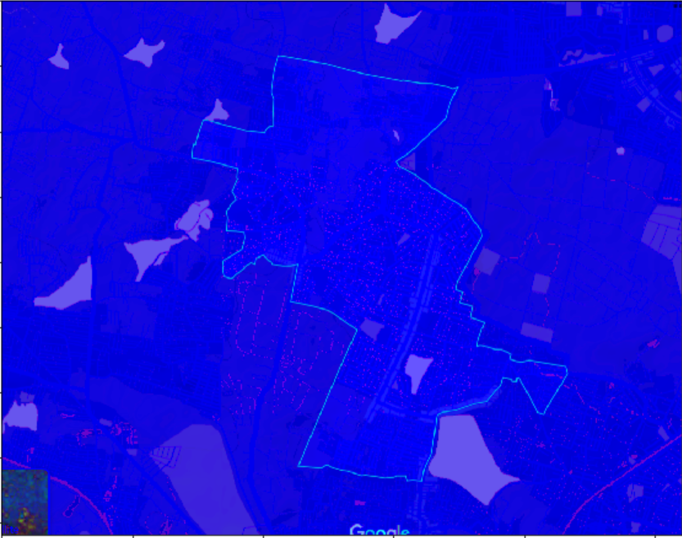
HSV colour space of the map view

Slide 15
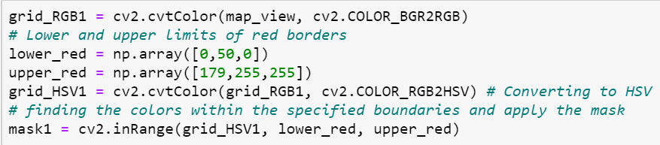
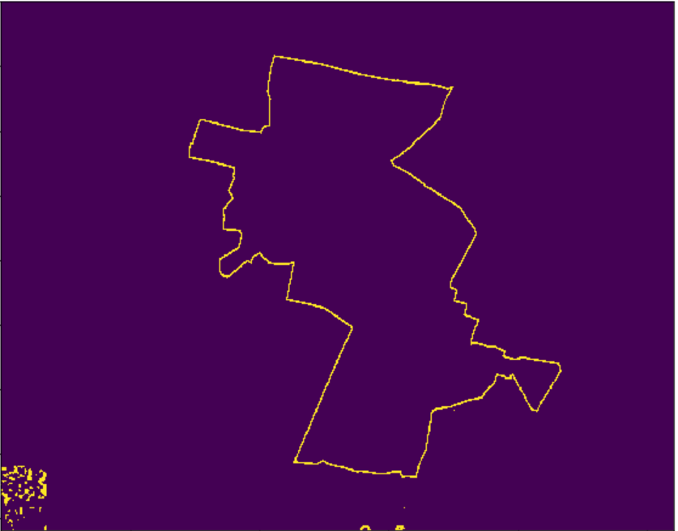
Obtaining mask for the HSV range

Slide 16
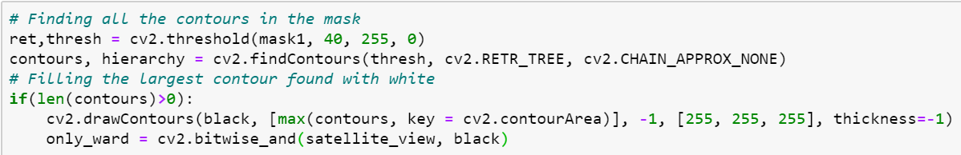
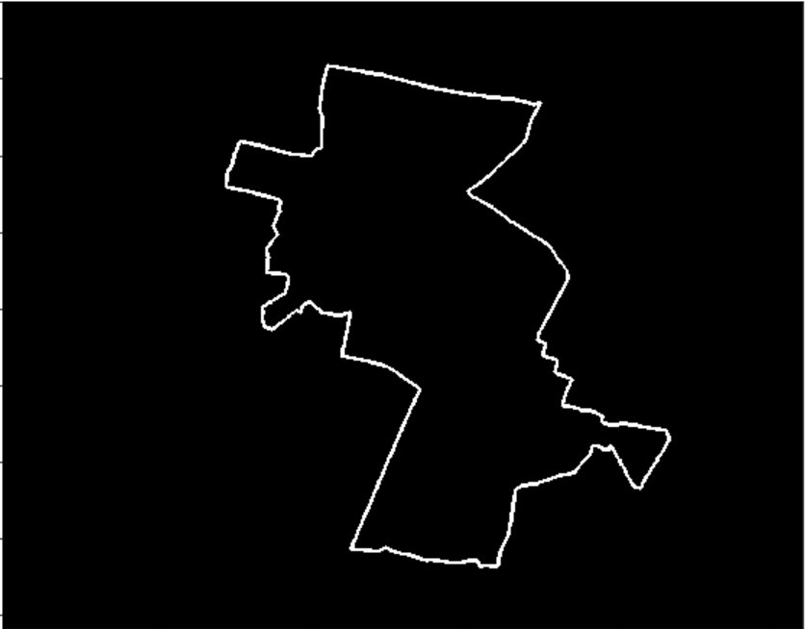
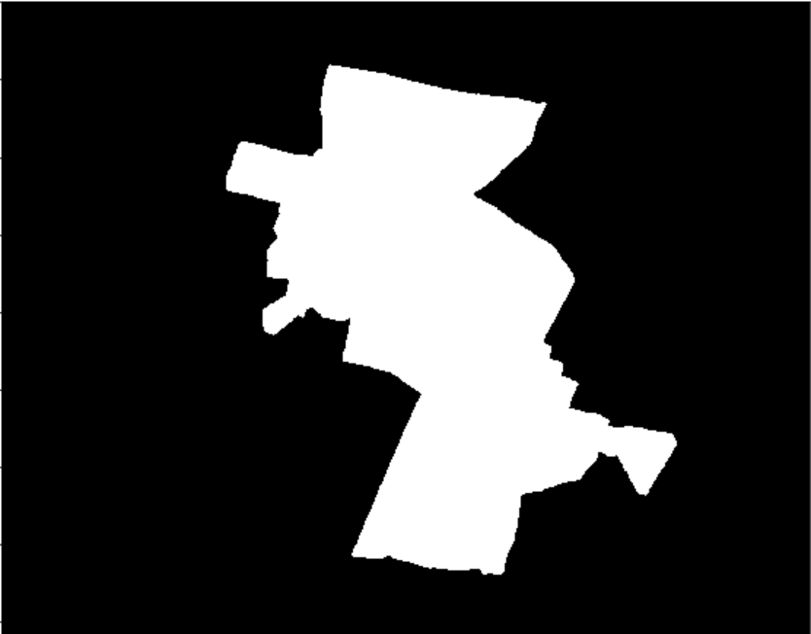
Finding the largest contour

Slide 17
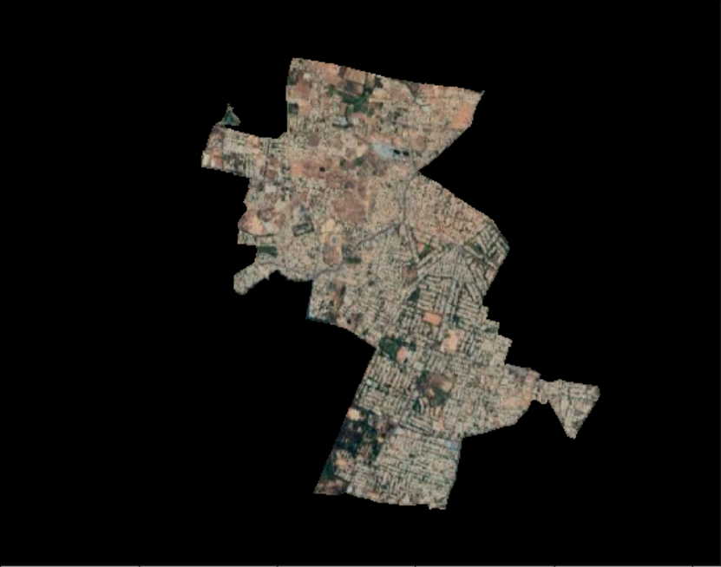
Bitwise AND with the satellite view

Slide 18
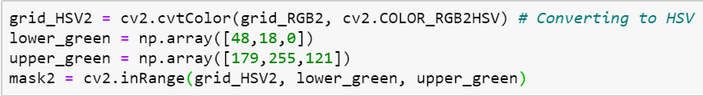
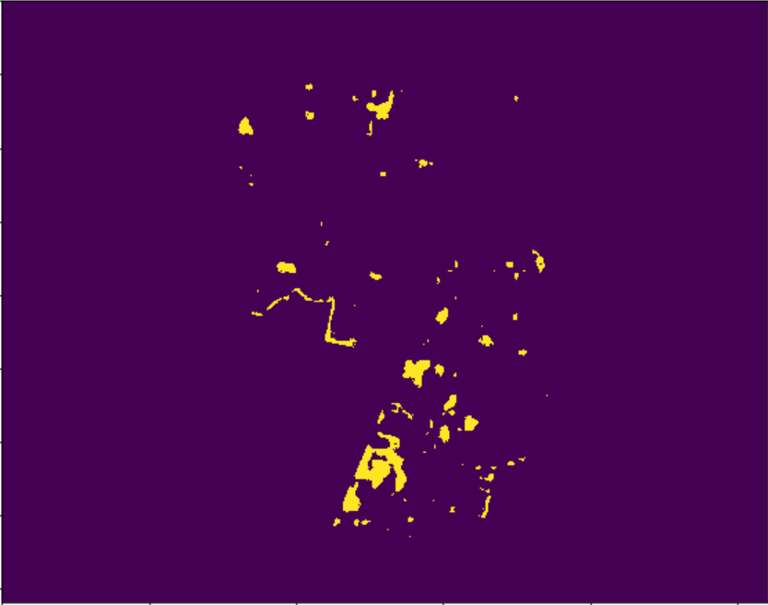
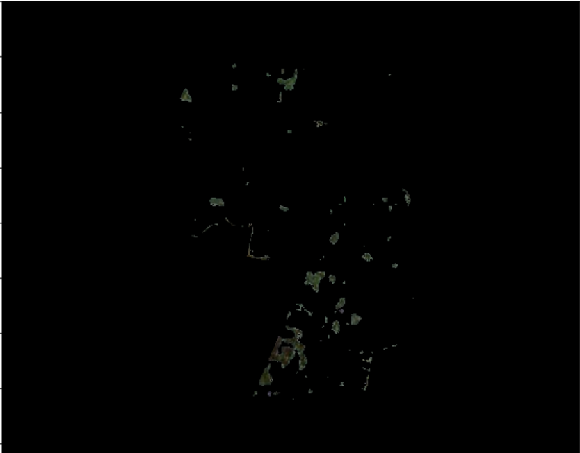
Applying the mask on the satellite view of ward

Slide 19
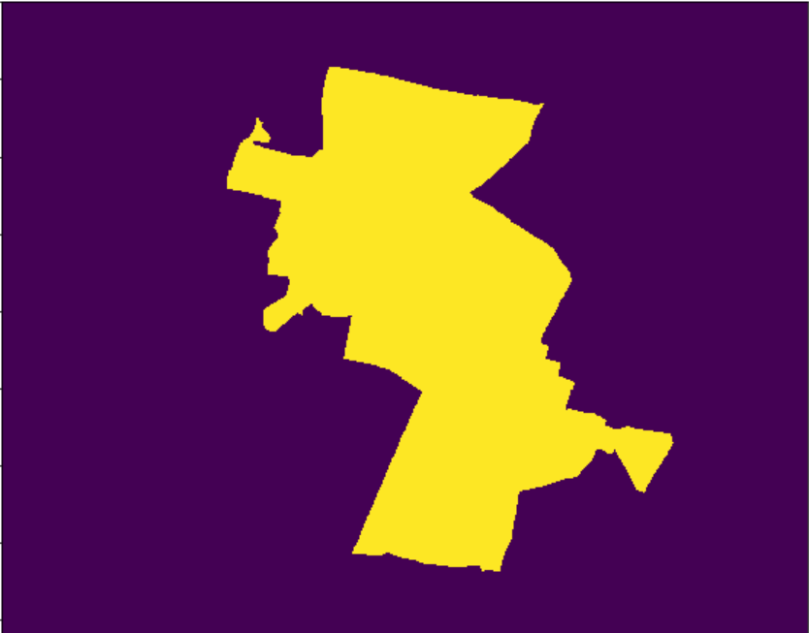
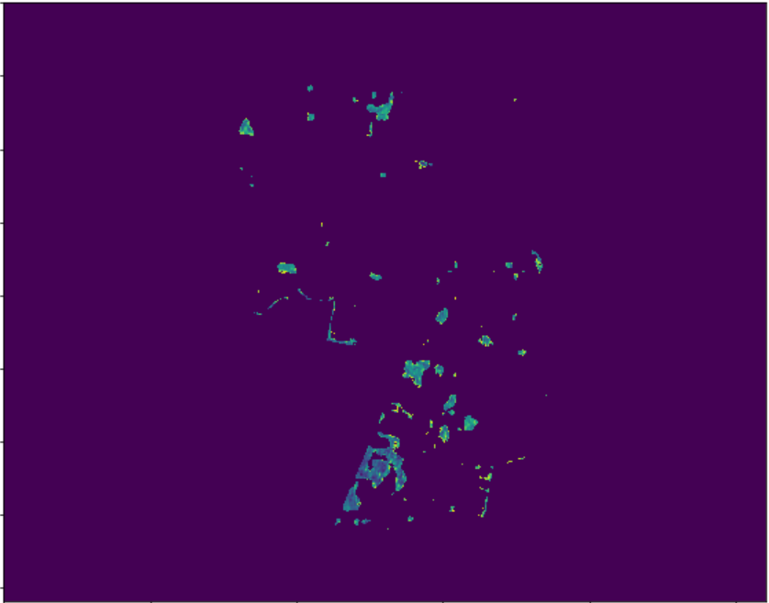
Area calculation through non-zero pixels
Single channel gray images of the ward and the green parts:

Slide 20
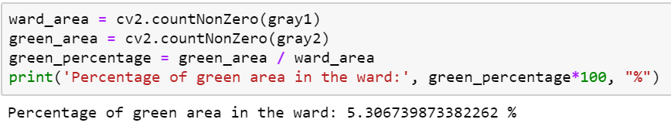
Percentage Area Calculation of the Green Parts

Slide 21
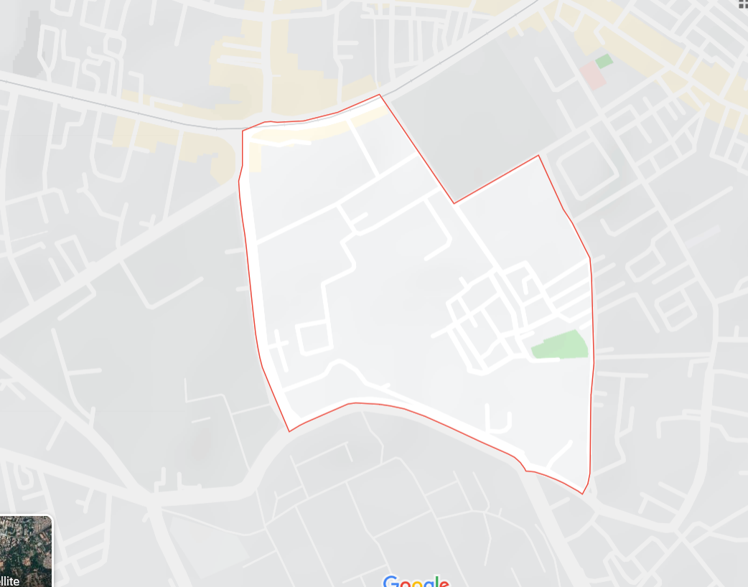
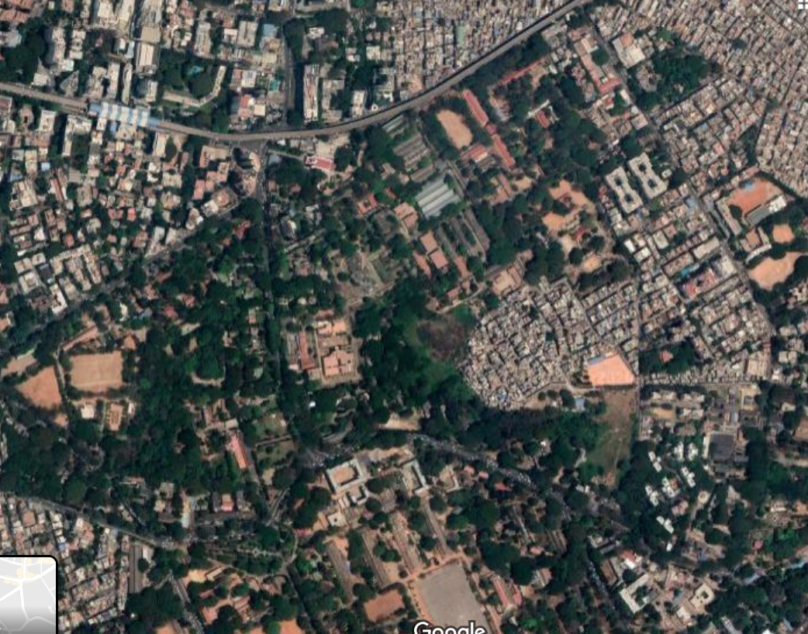
Ward with Highest Green Parts
Ward-89 : Jogupalya Ward
Jogupalya map view
Jogupalya satellite view

Slide 22
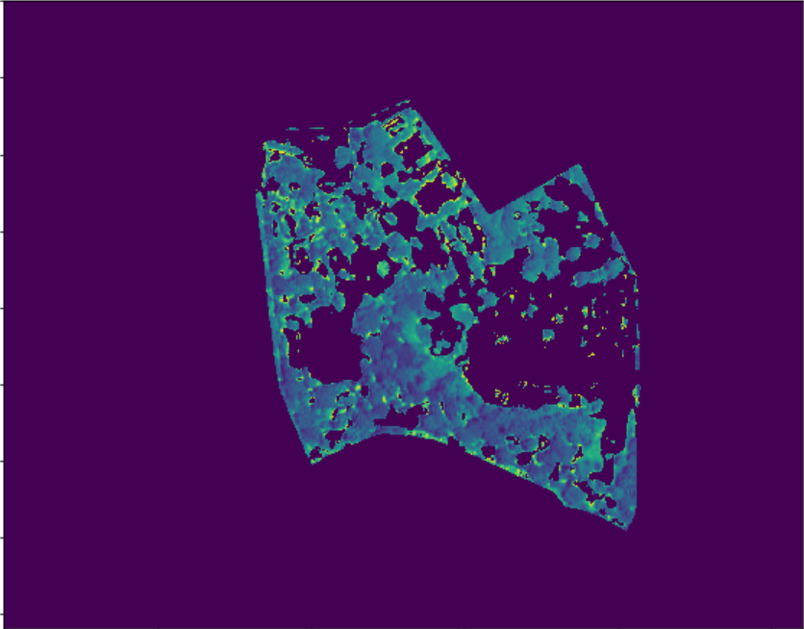
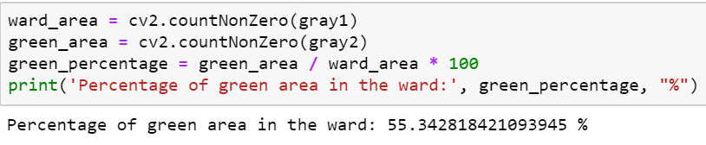
Ward with Highest Green Parts

Slide 23
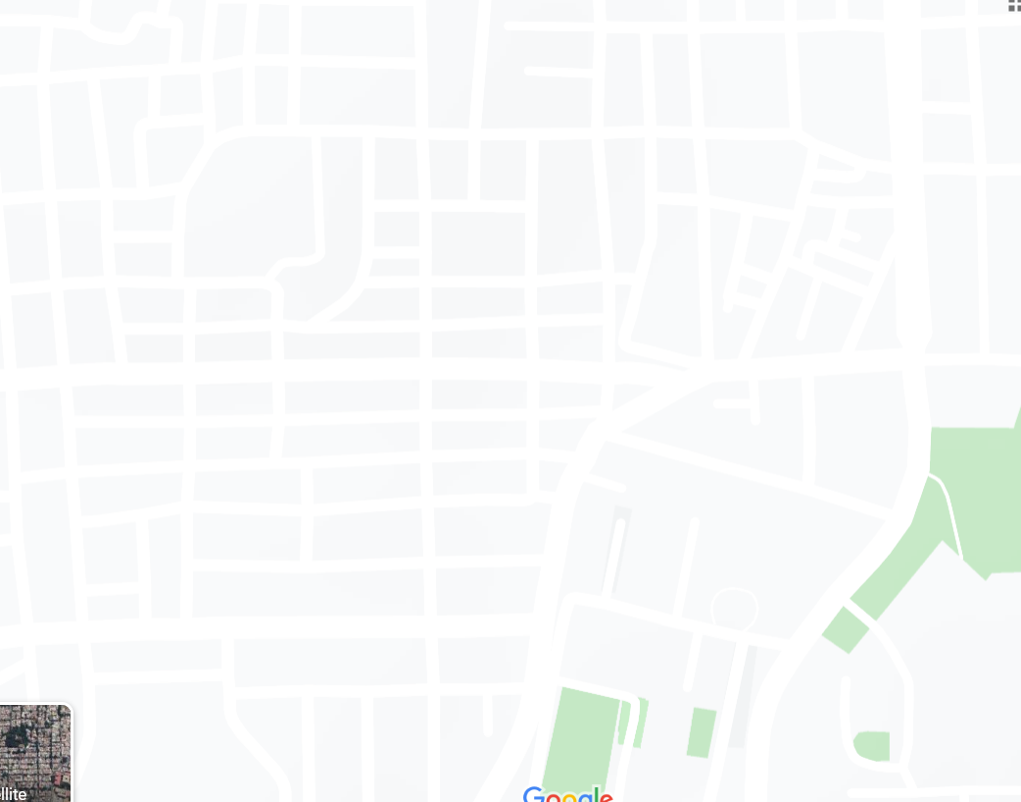
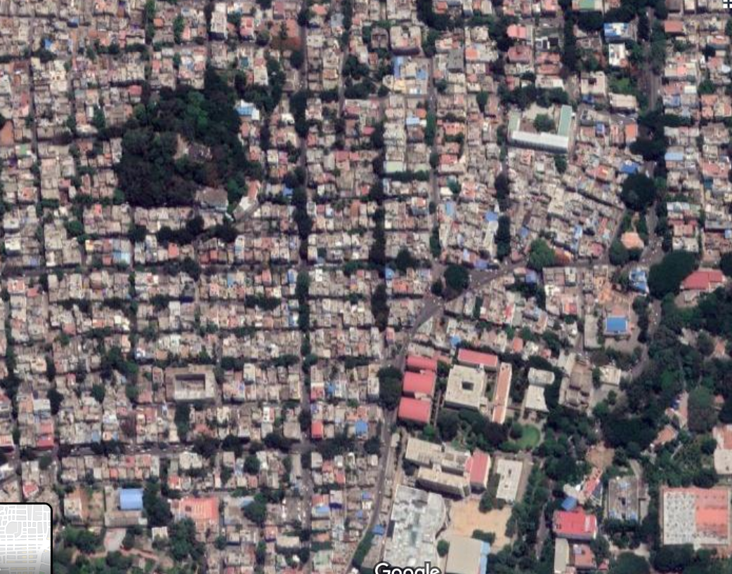
Wards without boundaries
Ward-142: Sunkenahalli Ward
Sunkenahalli map view
Sunkenahalli satellite view

Slide 24
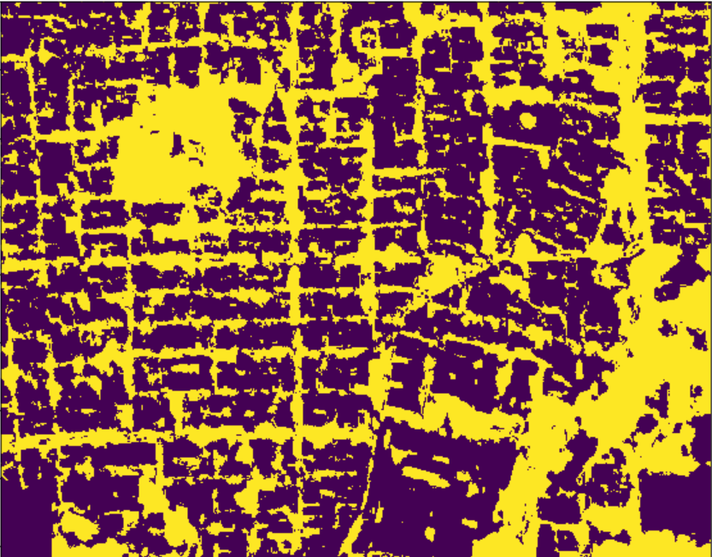
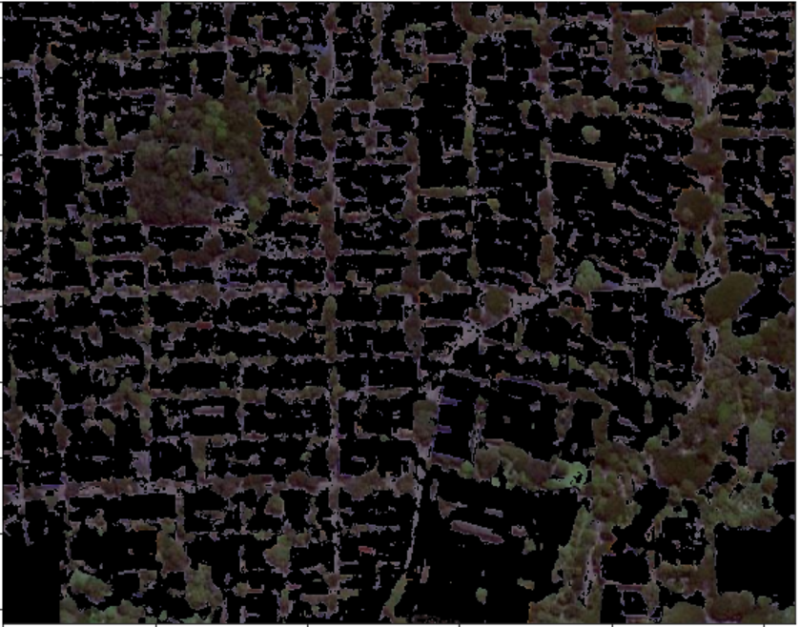
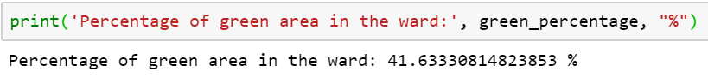
Wards without boundaries
Ward-142: Sunkenahalli Ward

Slide 25
DATA ANALYSIS HADOOP

Slide 26
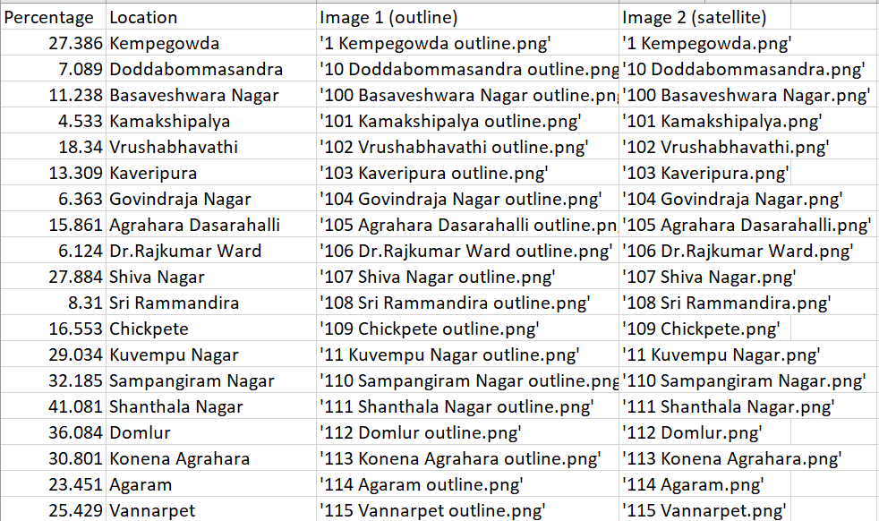
INPUT

Slide 27
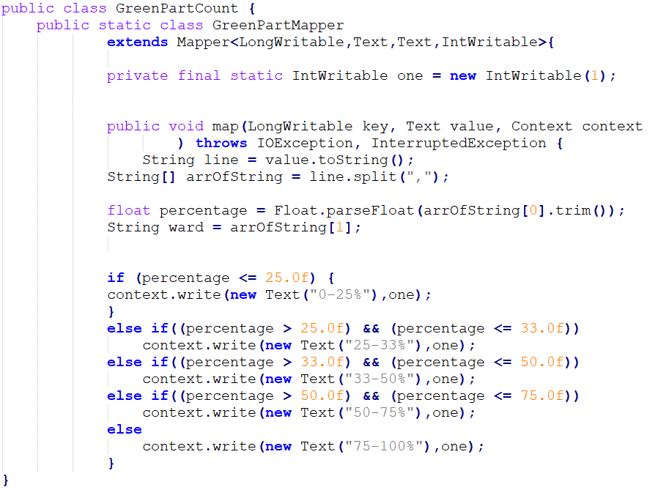
MAP - REDUCE

Slide 28
MAP
<0-25% , 1>
(137)
<25-33% , 1>
(33)
MAP
<Percentage,Location,Image1,Image2>
<Percentage,
Location>
(Split)
<33-50% , 1>
(26)
<50-75% , 1>
(2)
<75-100% , 1>
(0)

Slide 29
COMBINE
<25-33%, 1>
<0-25% , 1,1,1…>
<0-25%, 1>
COMBINE
&
SHUFFLE,
SORT
<25-33% , 1,1,1…>
<0-25%, 1>
<33-50% , 1,1,1…>
<33-50%, 1>
<50-75% , 1,1>
<0-25%, 1>
.
.
.

Slide 30
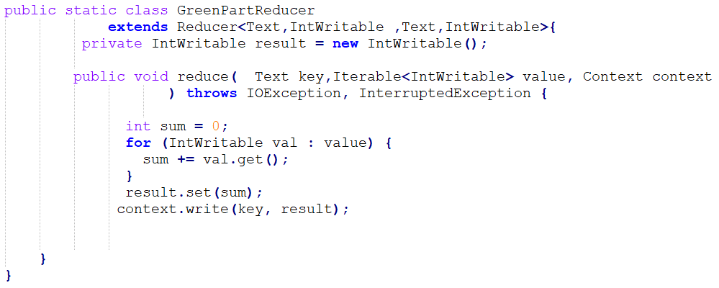
MAP - REDUCE

Slide 31
REDUCE
<0-25% , 137>
<0-25% , 1,1,1…>
REDUCE
<25-33% , 33>
<25-33% , 1,1,1…>
<33-50% , 26>
<33-50% , 1,1,1…>
<50-75% , 1,1>
<50-75% , 2>

Slide 32
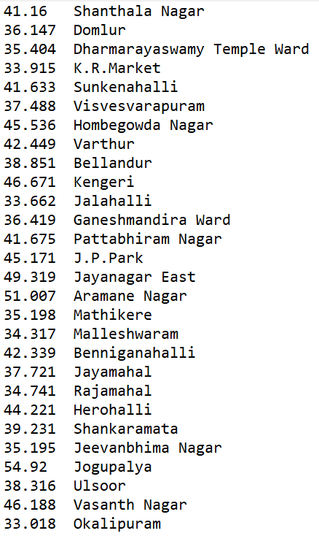
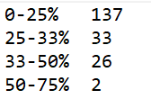
RESULT
<0-25% , 137>
<25-33% , 33>
<33-50% , 26>
<50-75% , 2>

Slide 33
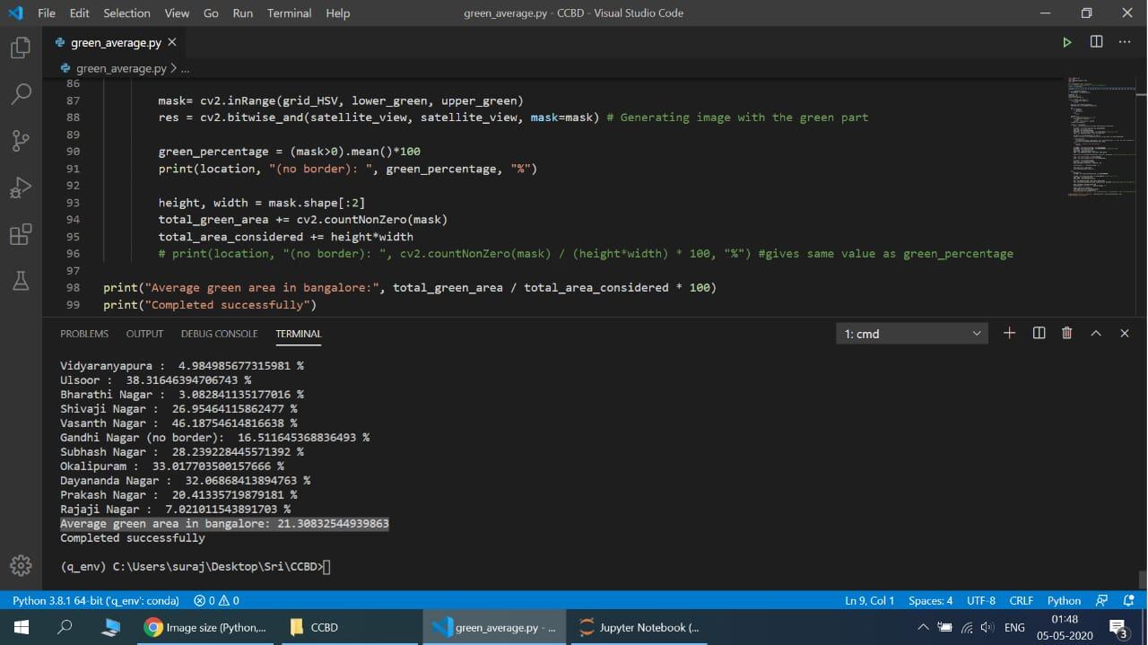
Average Green Cover in Bangalore

Slide 34
REFERENCE
https://www.researchgate.net/profile/T_V_Ramachandra/publication/318253283_Green_to_gray_Silicon_Valley_of_India/links/5a8d14f5458515a4068b2749/Green-to-gray-Silicon-Valley-of-India.pdf
“The dense vegetation cover of 68.27% (in 1973) has declined to
less than 25% (in 2012).”

Slide 35
REFERENCE
Ramachandra, T V & Aithal, Dr. Bharath & Kulkarni, Gouri & Shivamurthy, Vinay. (2017). GREEN SPACES IN BENGALURU: QUANTIFICATION THROUGH GEOSPATIAL TECHNIQUES. Indian Forester. 143. 307-320.
https://www.researchgate.net/publication/315670439_GREEN_SPACES_IN_BENGALURU_QUANTIFICATION_THROUGH_GEOSPATIAL_TECHNIQUES
“Overall improvements in human well-being in urban areas necessitate at least 33% green space that ensures at least 1.15 trees/person.”

Slide 36
THANK YOU!

